Slide 1
Face mask Detection
Simply Accurate
Srisharaan S,Vinothraj R,Pavankumar P

Slide 2
introduction
The current pandemic situation of COVID-19 has led to wear mask to safeguard us from others and the other way around too
We have come up with a solution to identify people not wearing Face masks.
This can be used in an institution or an industry where there are enormous people.
Our project uses deep learning algorithms to detect whether a person has worn a mask or not.

Slide 3
methodology
The dataset used here is Face Mask Detection provided by Larxel, São Paulo, State of São Paulo, Brazil.
It contains 853 images and 853 corresponding annotations which are used as labels for the model to be trained.
At least one of the dimensions of the image is 400 px in the dataset.
The label consists of the dimension of the images, whether a person has worn a mask or not and the position of the mask is represented with arguments xmin,ymin,xmax,ymax.

Slide 4
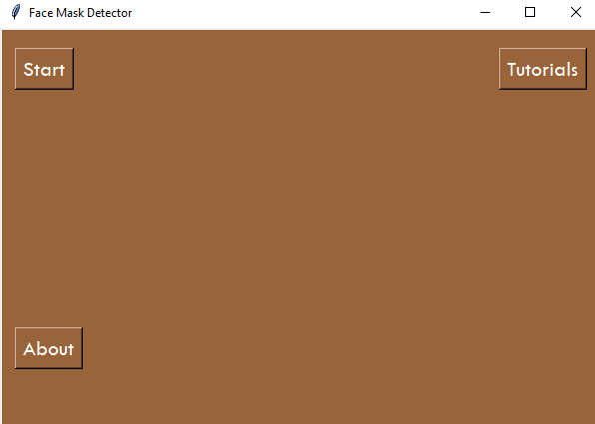
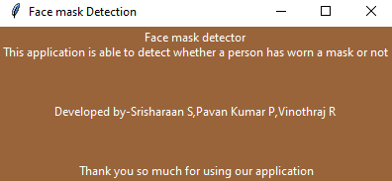
User interface
we have designed the gui using tkinter
There are three modules: Start,About,Tutorials
The start module calls the main program
The About module returns a message telling the information about the application

Slide 5
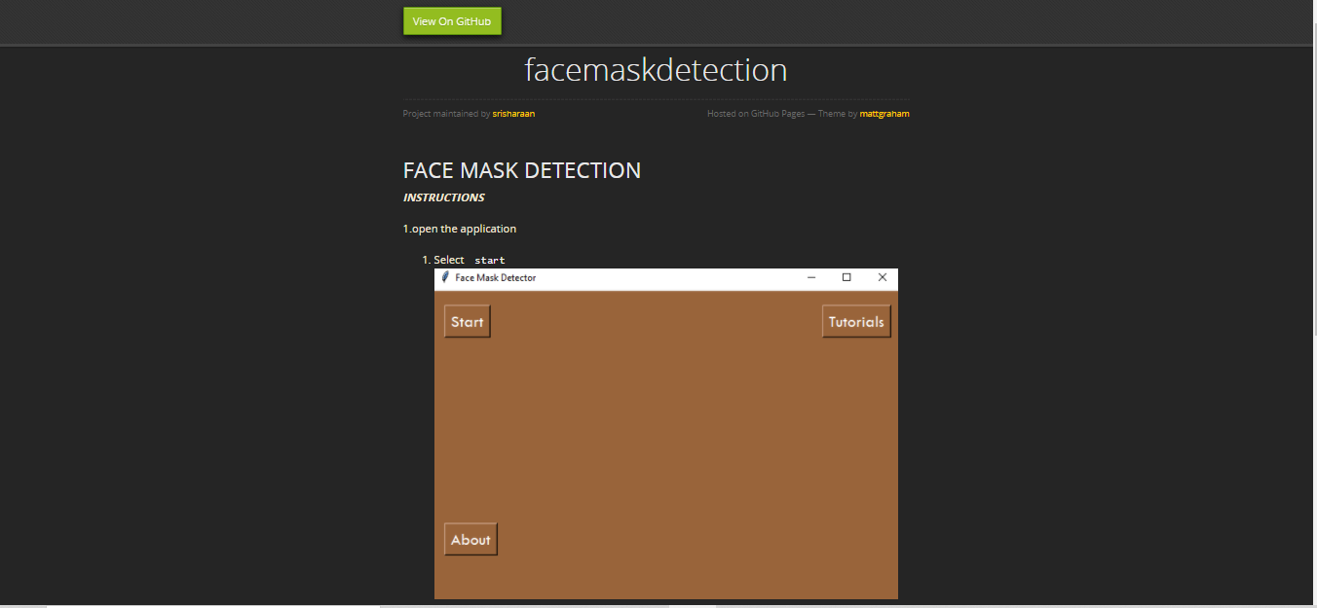
User interface
The tutorial page redirects us to the website which tells how to use the application

Slide 6
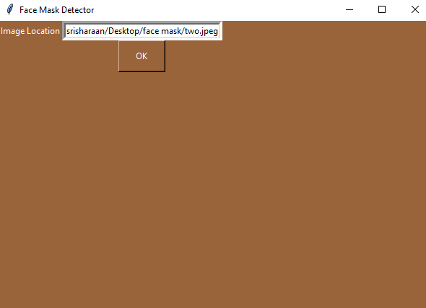
User interface
The Start navigates to the module where the path of the image is to be mentioned

Slide 7
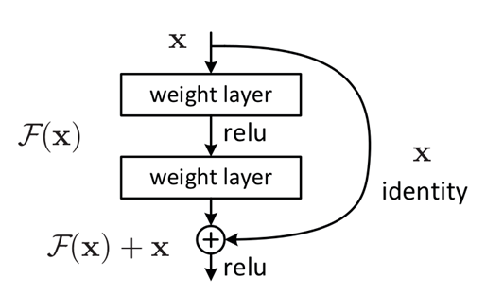
Training
The dataset is trained on a pretrained Resnet50 for 25 epochs
The ResNet was introduced by microsoft Research in 2015
The core idea exploited in these models, residual connections, is found to greatly improve gradient flow, thus allowing training of much deeper models with tens or even hundreds of layers
That helps in solving the vanishing gradient problem

Slide 8
Training
we used stochastic gradient descent with a learning rate of 0.005 and a momentum of 0.9
The final layer is replaced with 4 nodes of softmax layers
background
with mask
without mask
partially worn mask
The output is shown in the next slide

Slide 9
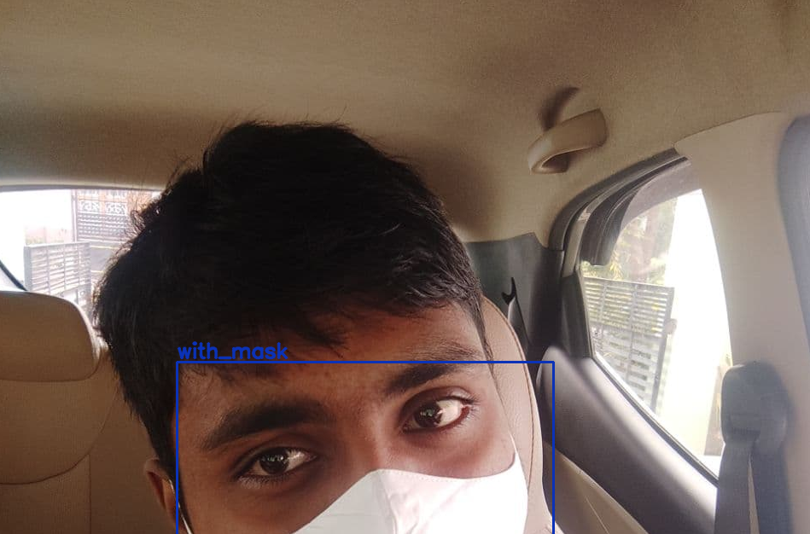
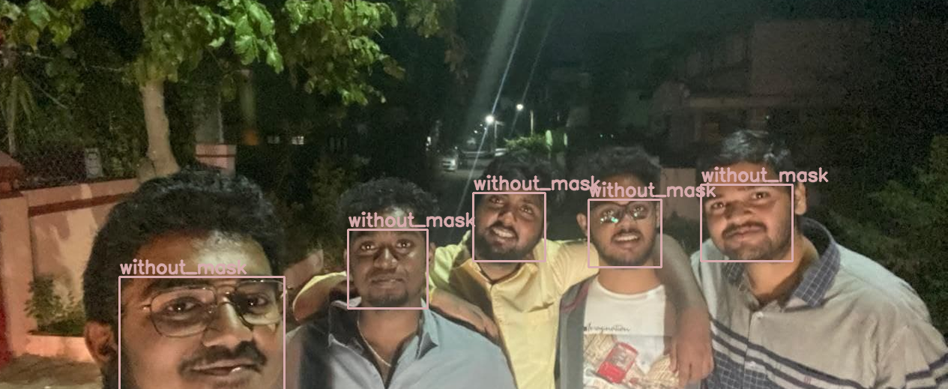
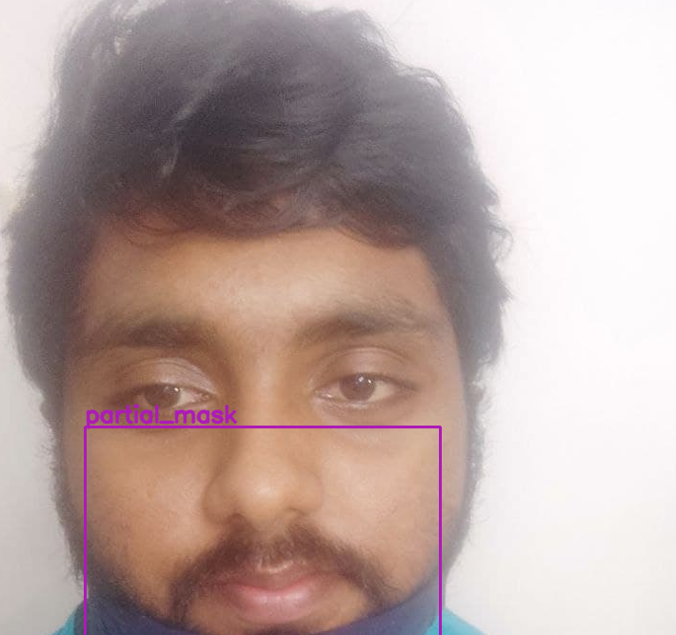
Output

Slide 10
Future Works
The next generation of transformers would be based on the transformer architecture
The vision transformer developed by facebook has already has least top 5 error in image.
In vision transformer the pixels are treated as vectors of inputs outputting query,key and value for the prediction

Slide 11
Conclusion
Thus our face mask detector will be useful in industries and institutions where there are enormous amount of people
Our future works include detecting people without face mask and comparing with the existing data base of images to send them a notification to wear a mask

Slide 12
THANK YOU
stay safe stay healthy...

